Slide 1
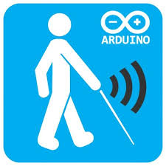
Review-1 Smart Stick For Blind
Using Arduino

Slide 2
Group Members
1
2
3
Rishabh Keshan
-19BCE2366
Pratishtha Gaur
-19BCE0104
Divij Bahl
-19BCE0789

Slide 3

REVIEW OBJECTIVES
Title
Application of Arduino in microprocessor
Problem Statement
Identifying gap between current and desired state
Literature Survey
Developing familiarity with other people’s work for reference

Slide 4

PROBLEM STATEMENT
Help the blind people manoeuvre in day to day lives without much work by using the auditory element and
Arduino
Ultrasonic sensors
Target population is the blind people and people with extreme cases of hypermetropia or myopia

Slide 5
ABSTRACT
A sensor is a device that converts one type of energy to another. Arduino is a small microcontroller board with a USB plug to connect to the computer. The Arduino board senses the environment by receiving input from a variety of sensors and can affect its surroundings by controlling LCD, speakers, motors and GS module. Ultrasonic Sensor measure the distance of target objects or materials through the air using “non-contact” technology. They measure distance without damage and are easy to use. The output Signals received by the sensor are in the analog form, and output is digitally formatted and processed by microcontroller. In present work, it is used to detecting an obstacle, along with its exact distance. The internal analog to digital converter is used is calibrated to get almost accurate distance measurement. The measured distance is also displayed on an LCD screen.

Slide 6
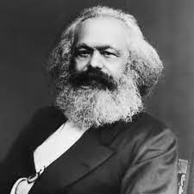
“Necessity is blind until it becomes conscious. Freedom is the consciousness of necessity.”
----Karl Marx

Slide 7
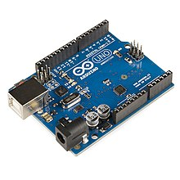
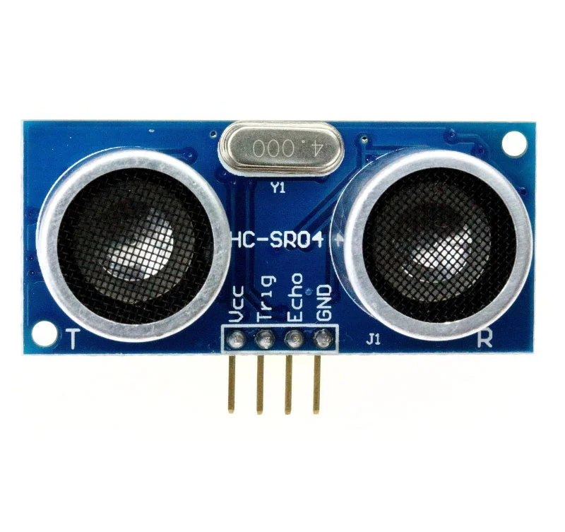
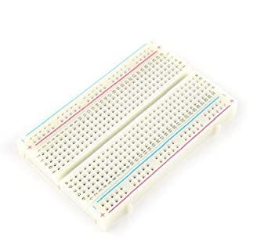
HARDWARE REQUIREMENTS
The following components are needed: -
Arduino board
bread board
set of ultrasonic sensors
a buzzer
connecting wires
9V battery

Slide 8
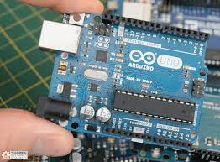
HARDWARE SPECIFICATION
Arduino Board
Arduino is an open-source electronics platform based on easy-to-use hardware and software. Arduino boards are able to read inputs - light on a sensor, a finger on a button, or a Twitter message - and turn it into an output - activating a motor, turning on an LED, publishing something online.ting wires and a 9V battery.

Slide 9
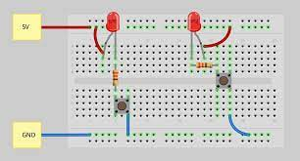
HARDWARE SPECIFICATION
2. Bread Board
A breadboard is a rectangular board with many mounting holes. They are used for creating electrical connections between electronic components and single board computers or microcontrollers﻿ such as Arduino and Raspberry Pi. The connections aren't permanent and they can be removed and placed again.

Slide 10
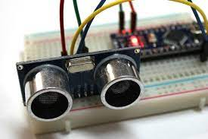
HARDWARE SPECIFICATION
3. Ultrasonic Sensors
Ultrasonic sensors are used around the world, indoors and outdoors in the harshest conditions, for a variety of applications. Our ultrasonic sensors, made with piezoelectric crystals, use high frequency sound waves to resonate a desired frequency and convert electric energy into acoustic energy, and vice versa.

Slide 11
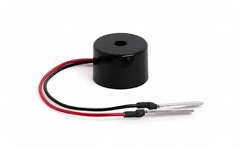
HARDWARE SPECIFICATION
4. Buzzer
A buzzer or beeper is an audio signaling device, which may be mechanical, electromechanical, or piezoelectric (piezo for short). ... Typical uses of buzzers and beepers include alarm devices, timers, and confirmation of user input such as a mouse click or keystroke.

Slide 12
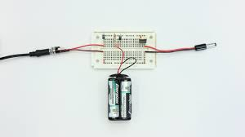
HARDWARE SPECIFICATION
5. Battery and Wires
A battery is a source of energy which provides a push - a voltage - of energy to get the current flowing in a circuit. A bulb uses the electrical energy provided by the battery, but does not use current.
Wire carries the circuit back to the original power source. More specifically, neutral wire brings the circuit to a ground or busbar usually connected at the electrical panel.

Slide 13
LITERATURE SURVEY
NO​ | TITLE​ | IMPLEMENTATION | CONCLUSION
1.​ | Distance Measurement via Using of Ultrasonic Sensor | Almost all materials reflect sound waves, so ultrasonic sensors are a fine choice for many tasks. Excellence in the detection and measurement of films, transparent objects, and liquids separate these sensors from their photoelectric counterparts. Due to their use of sound waves, ultrasonic sensors also perform well in dusty, dirty environments. | Ultrasonic sensors have variety application as distance measurement, obstacle avoiding and anti-collision detection, robot navigation, measurement in automotive parking assistance systems, measurement of air flow velocity - anemometer, medical ultrasonography, nondestructive testing, piezoelectric transducers, level measurement, pallet detection on forklifts, vehicle detection in barrier systems etc.
2.​ | Stick for Visually Impaired People Using Ultrasonic Sensors | In this paper writer has placed ultrasonic sensors at specific positions to the cane which provided information about the environment to the user by activating the buzzer sound water or dark areas through beeping sounds. The system consists of obstacle and moisture detection sensors for receiving, processing and sending signals to the alarm system which finally alerts the user for prompt action. | Some inventions require a separate power supply and have bulky design which exhausts user. This assistive technology will detect obstacle and provide alternate routes, will alarm user through vibrations to determine obstacle direction using ultrasonic sensors.

Slide 14
NO​ | TITLE​ | IMPLEMENTATION | CONCLUSION
3.​ | Distance Sensing with Ultrasonic Sensor and Arduino | In this paper we read about distance sensing. The Ultrasonic sensor measures distance without damage and are easy to use. The output Signals received by the sensor are in the analog form, and output is digitally formatted and processed by microcontroller. | The output Signals received by the sensor are in the analog form, and output is digitally formatted and processed by microcontroller. It is used to detecting an obstacle, along with its exact distance.
4.​ | The working principle of an Arduino | This paper explores the working principle and applications of an Arduino board. This also explores on how it can be used as a tool for study and research works. | These days many people try to use the arduino because it makes things easier due to the simplified version of C++ and the already made Arduino microcontroller

Slide 15
NO​ | TITLE​ | IMPLEMENTATION | CONCLUSION
5.​ | Evaluation of Method of Measuring Distance Between Object and Walls Using Ultrasonic Sensors | This paper is concerned with the development of an ultrasonic wave sensor system. A development of the sensor system a the robot which moves in the parallel to the wall is proposed. Ultrasonic wave frequency is 40 kHz. The sensor output is calculated with a PIC (computer), and it is displayed by a LCD screen. | The architecture to introduce an ultrasonic wave sensor system for the moving environment is proposed. This architecture is simple, so it is applicable to measurement of the positioning control study. A sensor system was developed using only inexpensive and easily available components. Based on the information obtained while designing, manufacturing and testing the prototype, it was concluded that the system proved to be sufficiently capable for use by robots.

Slide 16
NEW FEATURES
Signals Warning
Directs people
Ultrasonic sensors detect obstacle and based on the intensity or speed the buzzer will buzz to warn the user
Ultrasonic sensors are capable of detecting distance of obstacle which will help guide the user
SOS Call
Economic
A few emergency numbers will be already given to the code
Cost of ultrasonic sensor is not much thus the product can be made in a cost efficient manner

Slide 17
REFERENCES
Dada Emmanuel Gbenga et al.,"Stick for Visually Impaired People Using Ultrasonic Sensors", / International Journal of Engineering and Technology (IJET),doi:10.21817/ijet/2017/v9i5/170905302
N. A. Latha, B. R. Murthy and K. B. Kumar, "Distance Sensing with Ultrasonic Sensor and Arduino", International Journal of Advance Research Ideas and Innovations in Technology, vol. 2, no. 5, pp. 1-5, 2016.
Michal Kelemen, Ivan Virgala, Tatiana Kelemenová, Ľubica Miková, Peter Frankovský, Tomáš Lipták, and Milan Lörinc, “Distance Measurement via Using of Ultrasonic Sensor.” Journal of Automation and Control, vol. 3, no. 3 (2015): 71-74. doi: 10.12691/automation-3-3-6.
Y. A. Badamasi, "The working principle of an Arduino," 2014 11th International Conference on Electronics, Computer and Computation (ICECCO), 2014, pp. 1-4, doi: 10.1109/ICECCO.2014.6997578.
Evaluation of Method of Measuring Distance Between Object and Walls Using Ultrasonic Sensors - M. Ishihara, Makoto Shiina, Shin-nosuke Suzuki

Slide 18
Group Members
1
2
3
Rishabh Keshan
-19BCE2366
Pratishtha Gaur
-19BCE0104
Divij Bahl
-19BCE0789

Slide 19


